Slide 1


Exploring the Power of GoLang
GoLang, a versatile and efficient programming language, has emerged as a powerful tool for modern software development.

Slide 2

The Origins of GoLang
1
Inception
Created by Google engineers in 2009
2
Design Goals
Simplicity, efficiency, and reliability
3
Key Features
Concurrency, strong standard library

Slide 3

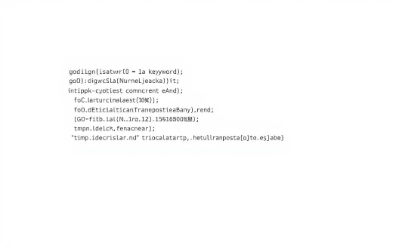
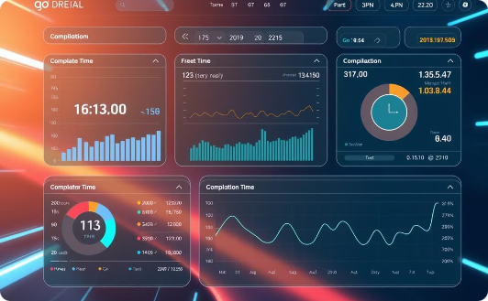
GoLang's Unique Approach
Concurrency
Syntax
Performance
Goroutines for seamless multi-tasking.
Clean and beginner-friendly design.
Fast compilation and toolchain support.

Slide 4
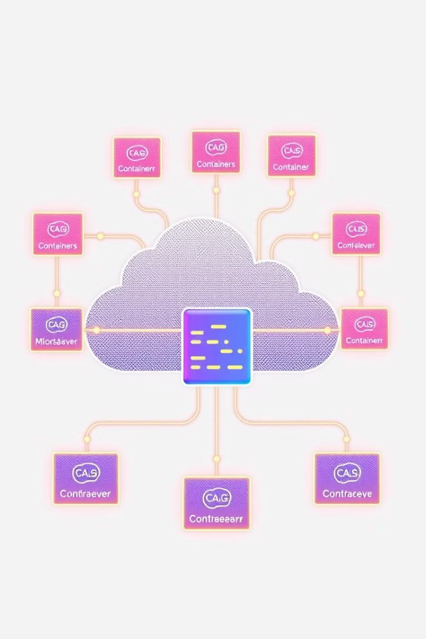
GoLang's Powerful Applications
1
Web Development
Powering leading projects like Docker and Kubernetes
2
Scalability
Handling high-performance and distributed systems
3
Community Support
Active and growing ecosystem of resources

Slide 5

Mastering GoLang
Learn the Basics
Syntax, data types, and control structures
Dive into Concurrency
Goroutines, channels, and synchronization
Explore the Ecosystem
Standard library, third-party packages, and tools
Practice and Experiment
Build projects, contribute to open source

Slide 6
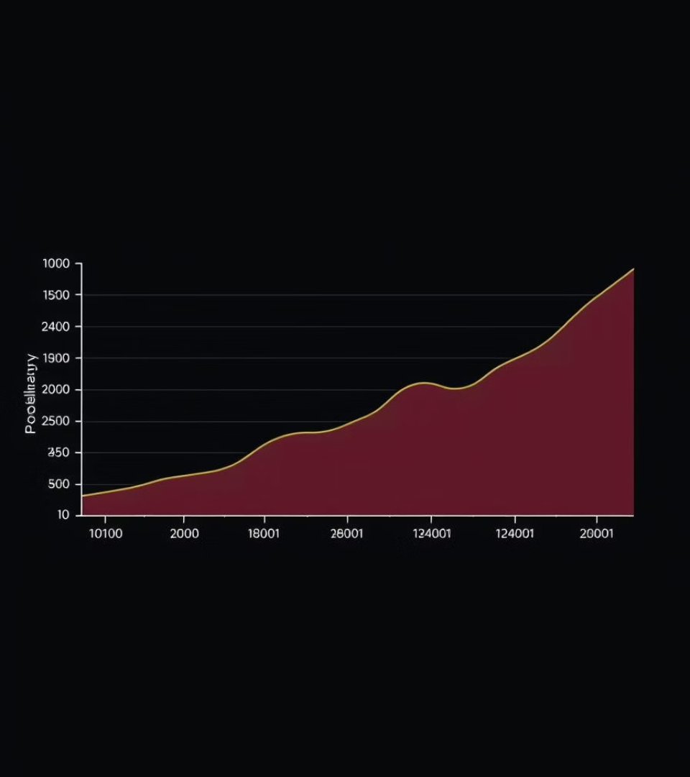




GoLang's Growing Popularity
Infrastructure
Powering cloud platforms and DevOps tools
High-Performance
Optimized for speed and efficiency
Collaboration
Strong community and open-source projects
Career Opportunities
Demand for GoLang skills is rising

Slide 7




GoLang's Versatility
Web Development
Building scalable and high-performance web apps
Network Programming
Developing reliable and efficient network tools
System Programming
Creating low-level and high-performance software

Slide 8

The Future of GoLang
Continued Evolution
Expanding Ecosystem
Emerging Use Cases
Language enhancements
More third-party packages
AI, IoT, and beyond
Improved tooling
Robust community support
Adapting to new challenges

